Slide 1

Introduction to Machine Learning 2
Classification

Slide 2
Copyright Notice
The material within this presentation, excluding externally sourced images and animations, is fully owned by the Curtin Machine Learning Club. No redistributing, modification, nor commercialisation is allowed without written consent from the copyright holder.
Copyright © 2022 Curtin Machine Learning Club

Slide 3
Acknowledgement of Country
Curtin University would like to pay our respect to the Aboriginal and Torres Strait Islander members of our community by acknowledging the traditional owners of the land on which the Bentley Campus is located, the Wadjuk people of the Nyungar Nation; and on our Kalgoorlie Campus, the Wongutha people of the North-Eastern Goldfields, past, present, and emerging.

Slide 4


Hardware Required

Slide 5
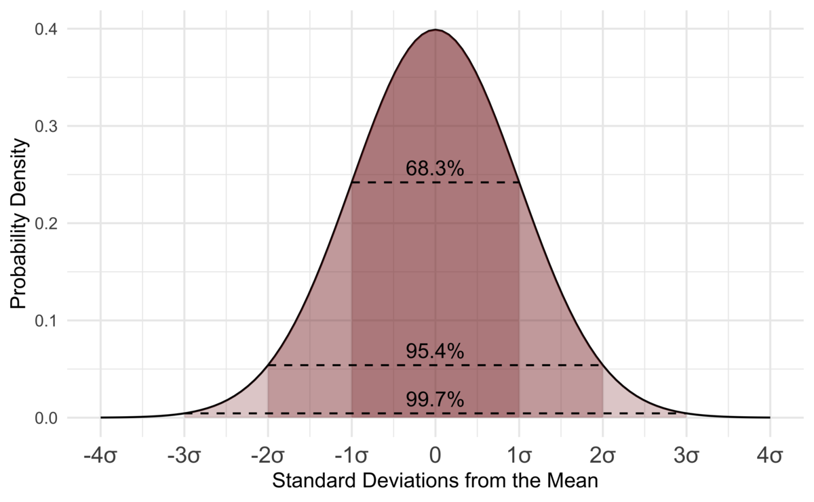

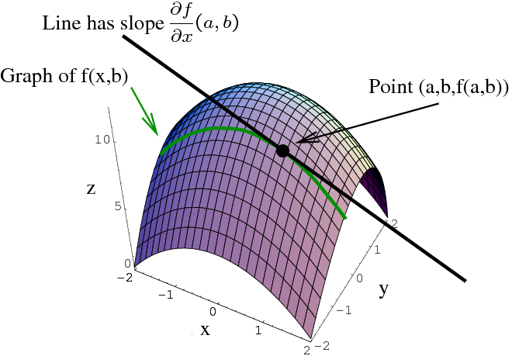
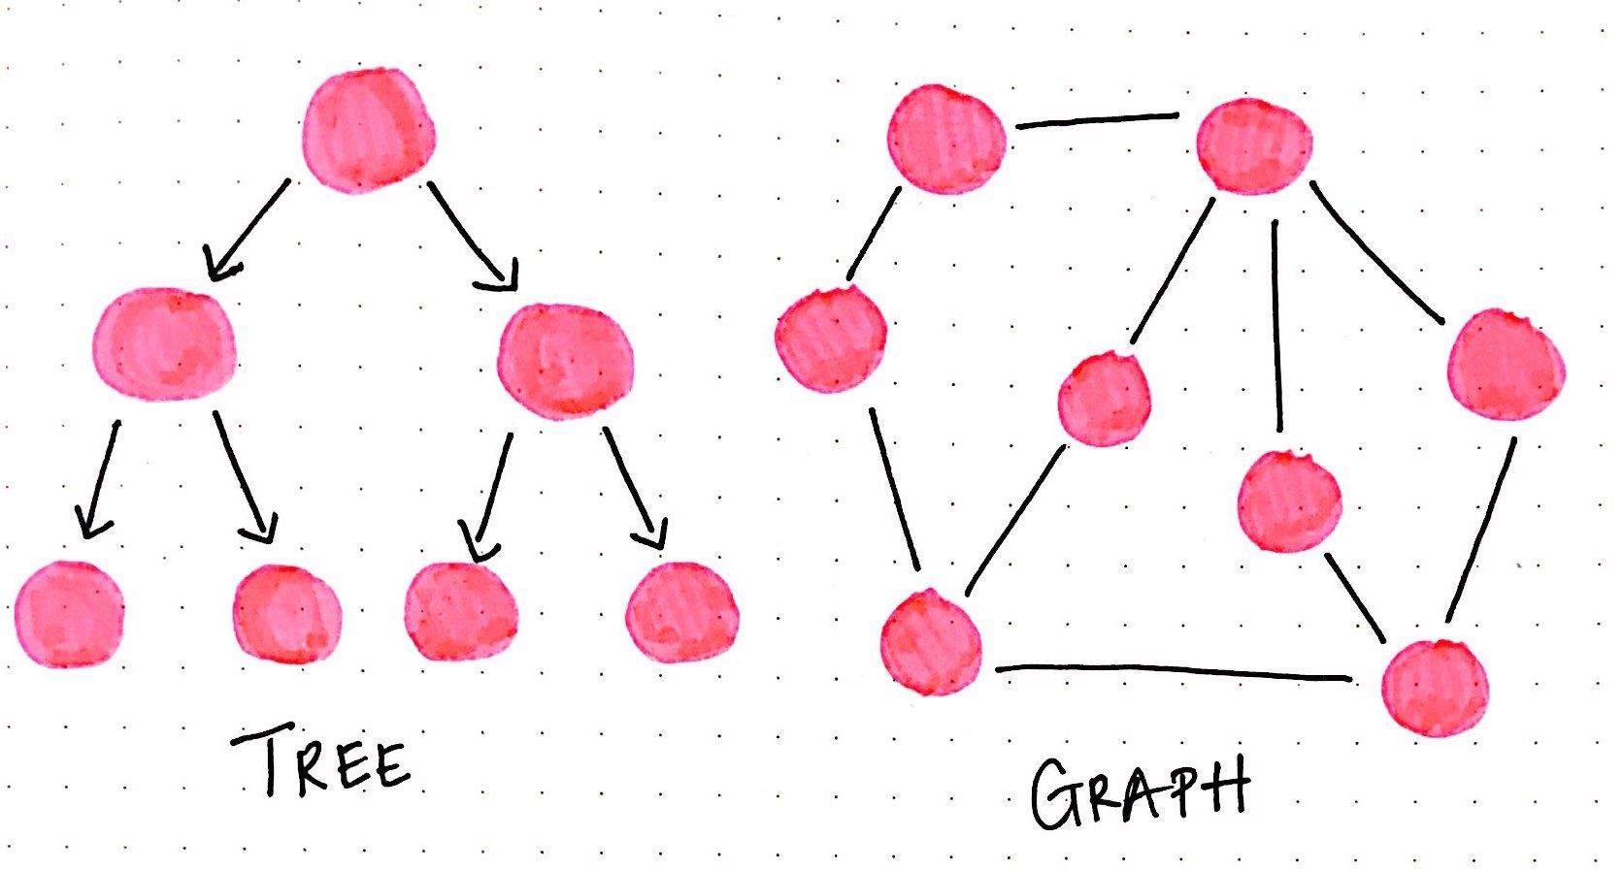
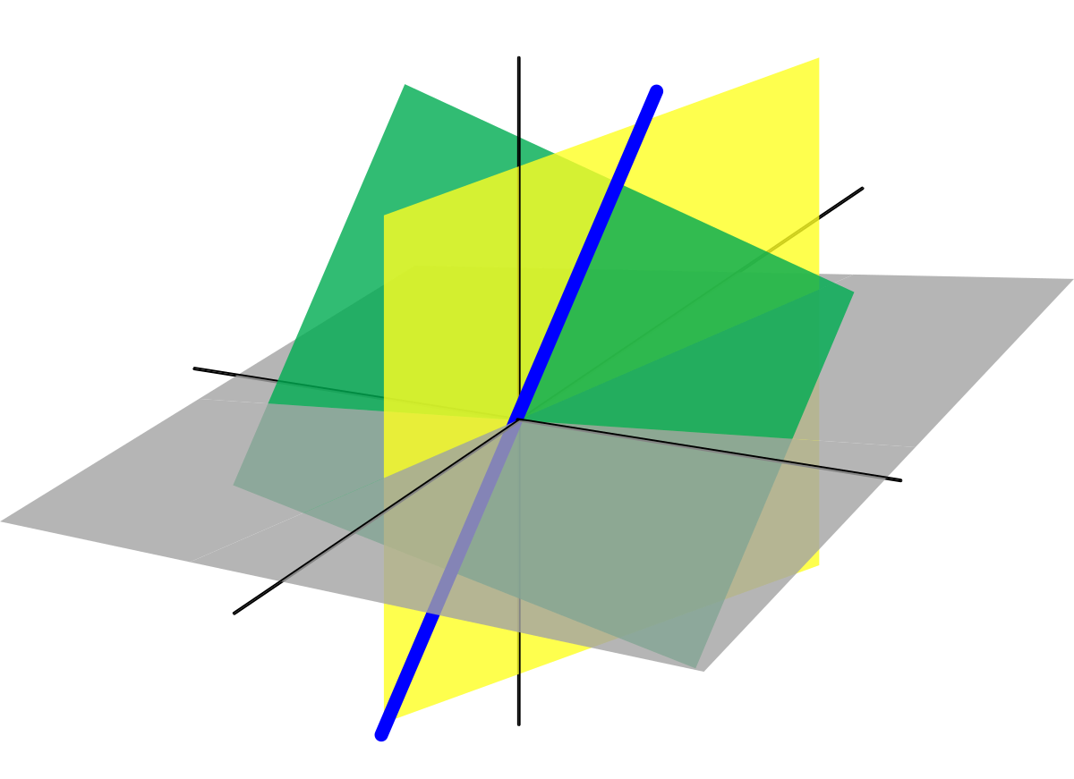
Machine Learning Mathematics

Slide 6
So What Happened Last Week?

Slide 7
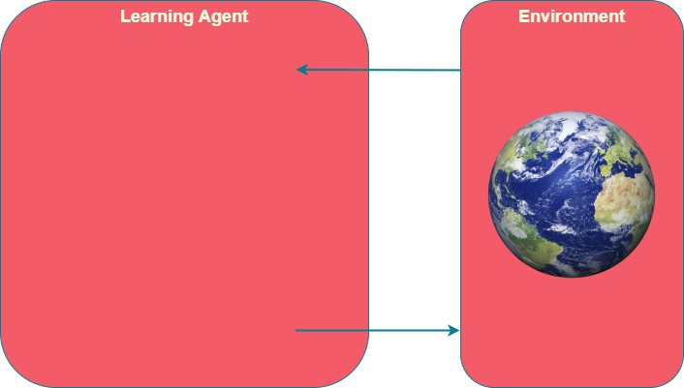
So What Was ML Again?

Slide 8
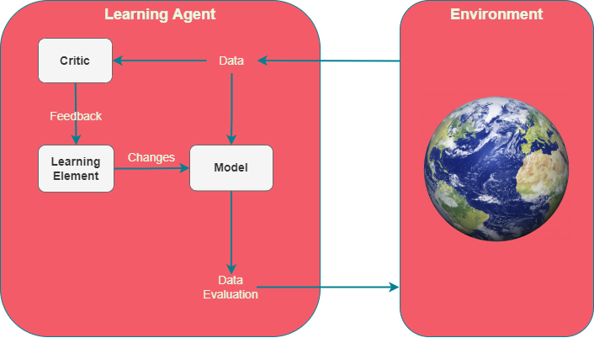
ML at its Core
Critic evaluates performance
Learning element learns from feedback
Model Analyses data

Slide 9
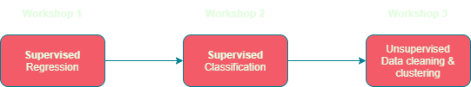
Workshop Timeline

Slide 10
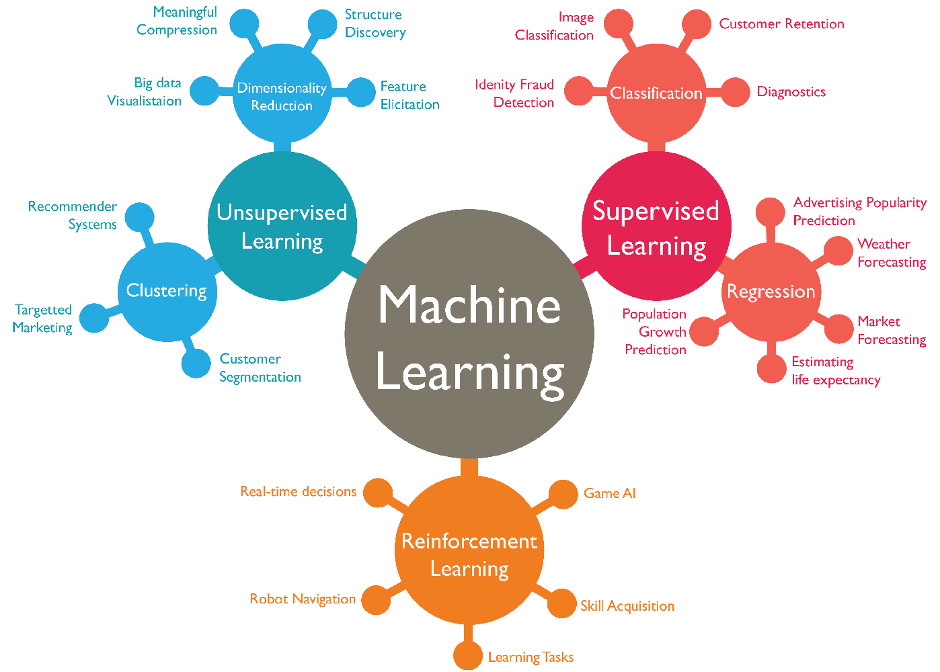
Main Types of ML
Supervised
Train a predictor
Unsupervised
Organise unstructured data
Reinforcement
Real time feedback

Slide 11
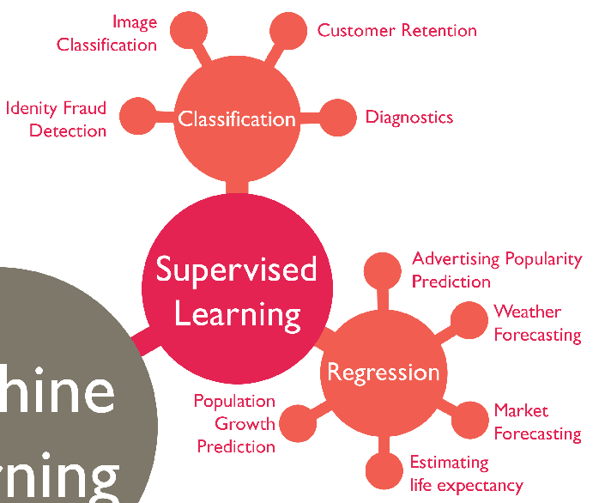
Supervised Learning
Needs training data
Manually labelled
Worst part about supervised!
Makes predictions

Slide 12
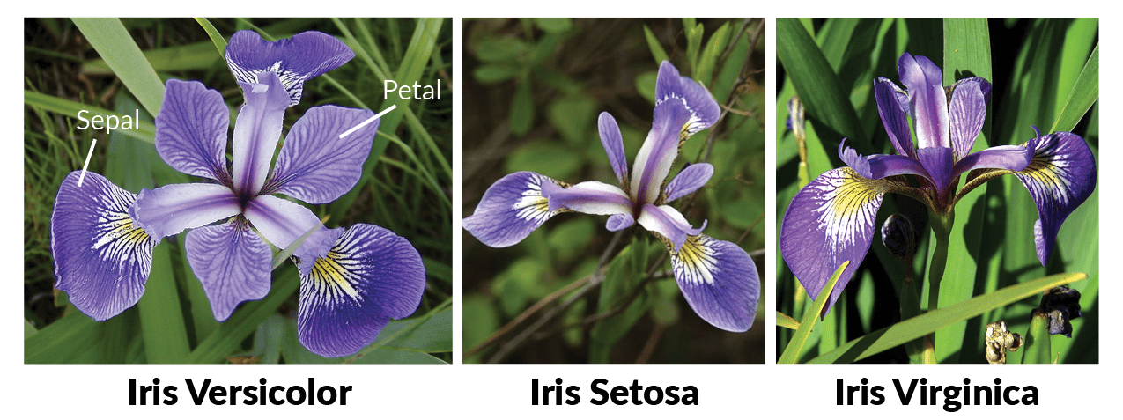
Iris dataset

Slide 13
What are features?
Model
Is it a dog?

Slide 14
How about these?
No. of legs
w1
Model
No. of eyes
w2
Is it a dog?
Mass
w3
Length
w4
w5
Exoskeleton

Slide 15
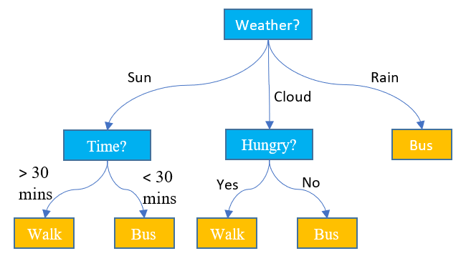
Decision Trees Intro
Easy to understand
Easy to use
Specific

Slide 16
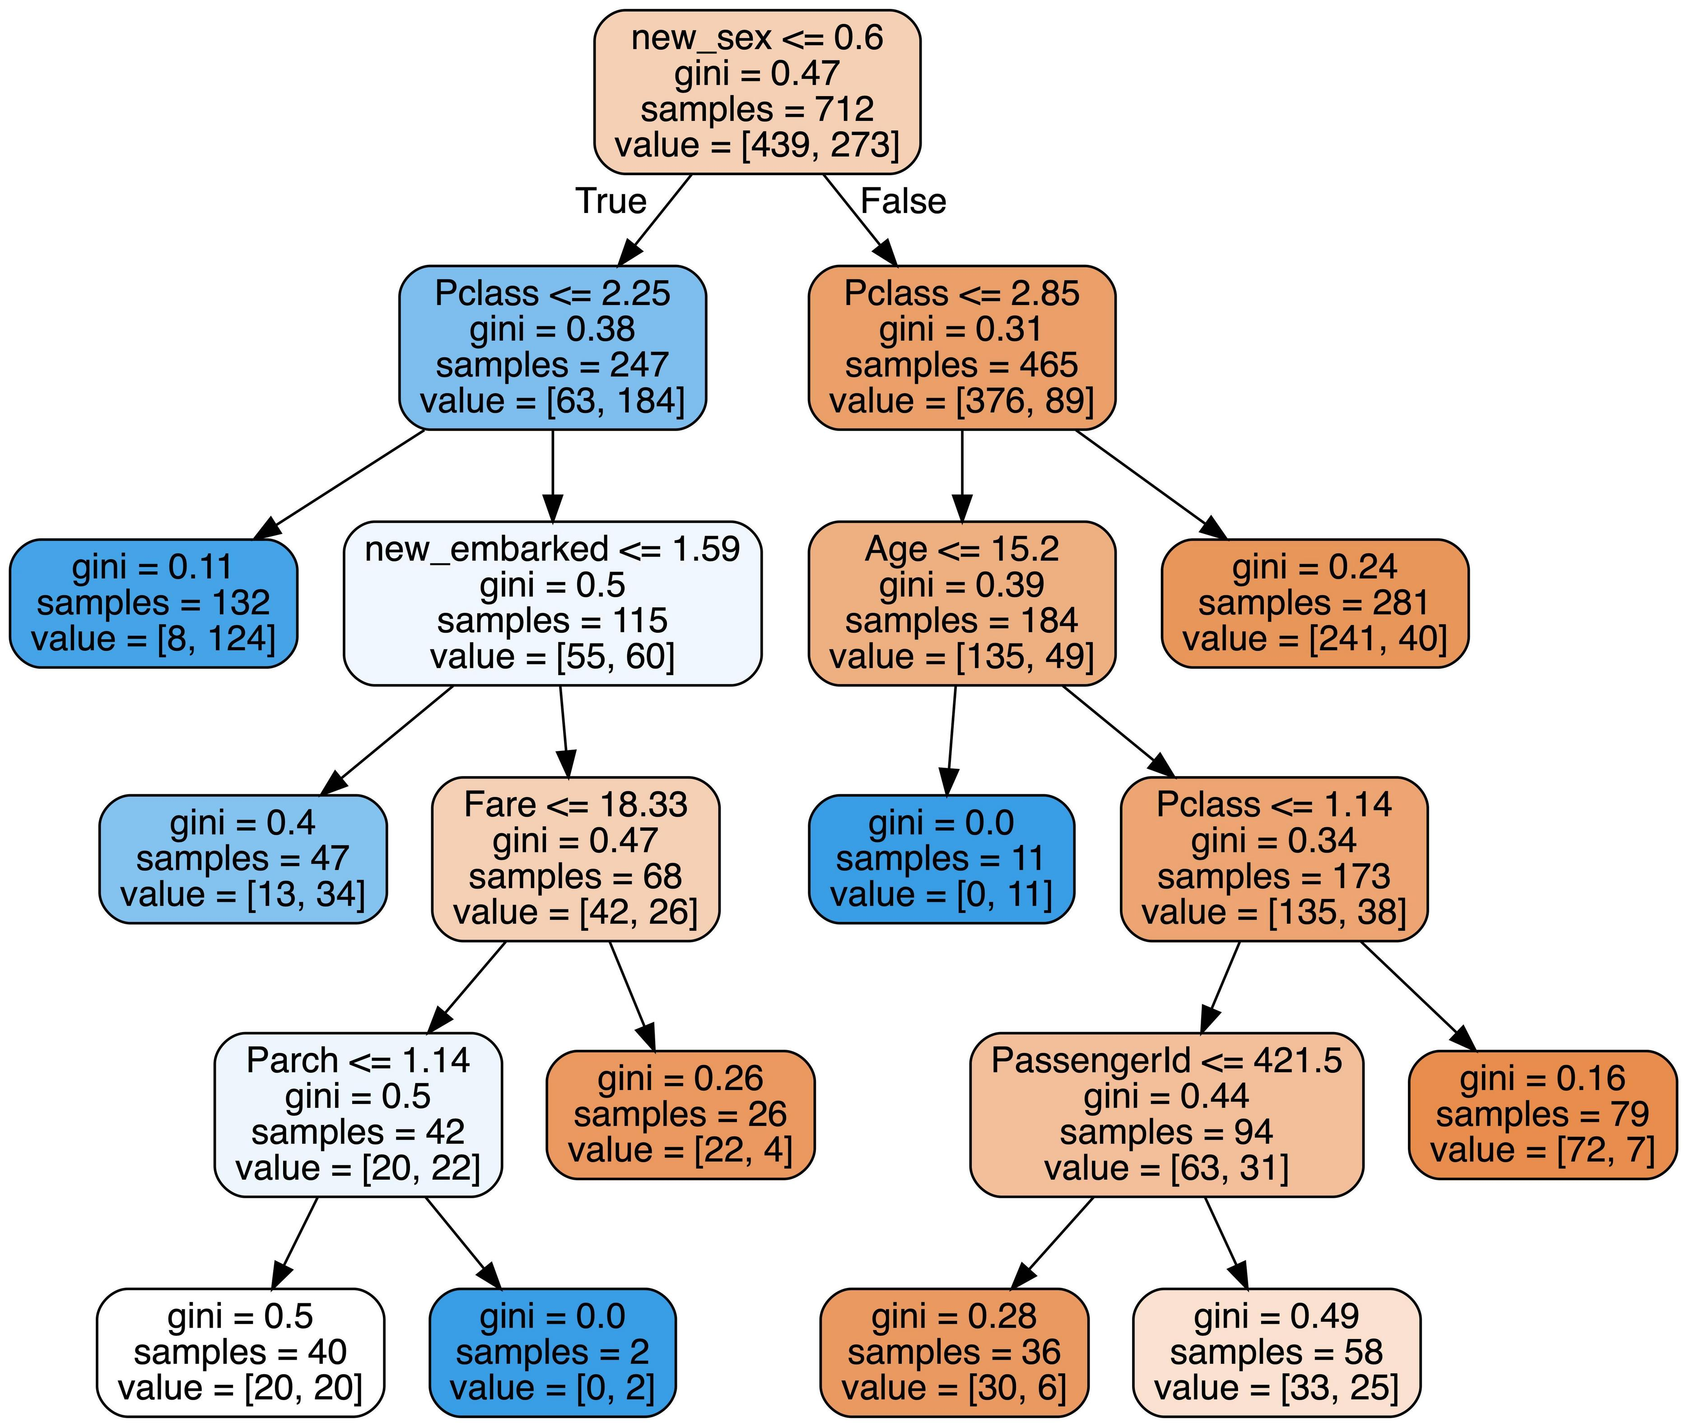
Simple Decision Tree
Always binary: if-else check
Splits data based on inequality.

Slide 17
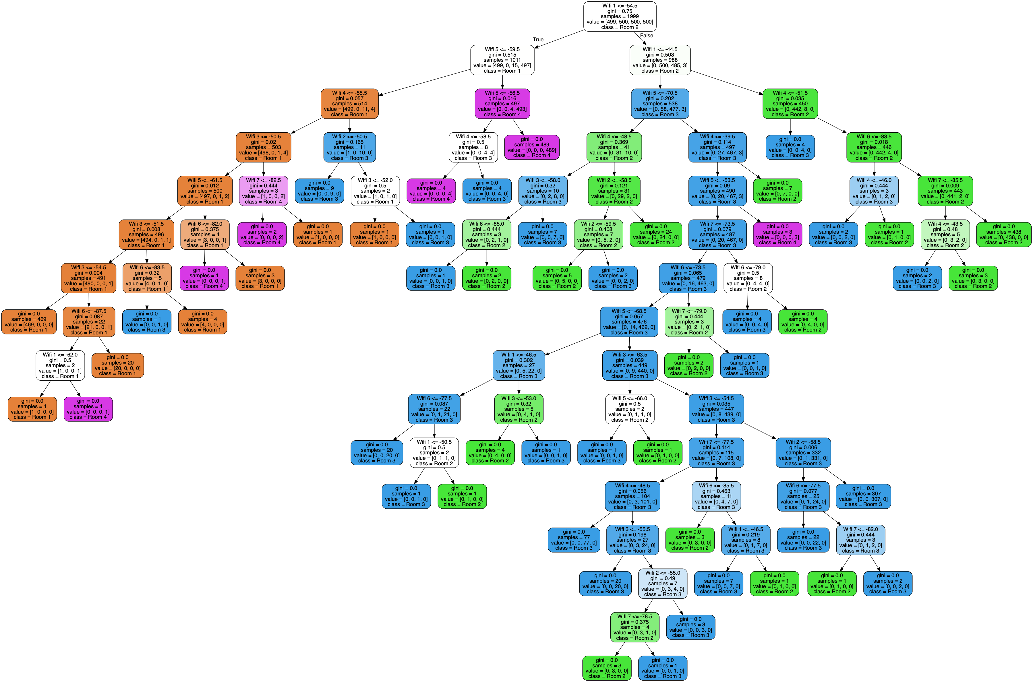
Big Decision Trees
Can become big in size.
Slow to compute.

Slide 18
How to Construct Trees?
GOAL: Minimise height
Lower height, less if-else checks
Brute force?
No, too many combinations
Need to be smart…

Slide 19
Every Decision is a Split
Blue: 3/9 chance
Green: 6/9 chance
Blue: 7/11 chance
Green: 4/11 chance

Slide 20

Information Gain

Slide 21
Gini Index

Slide 22
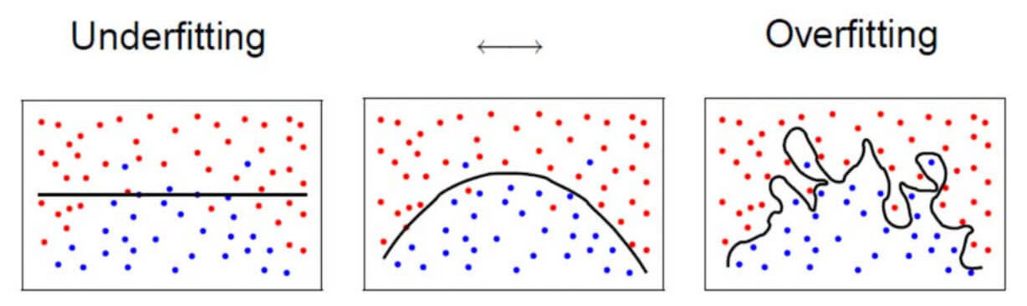
The Overfitting Issue

Slide 23
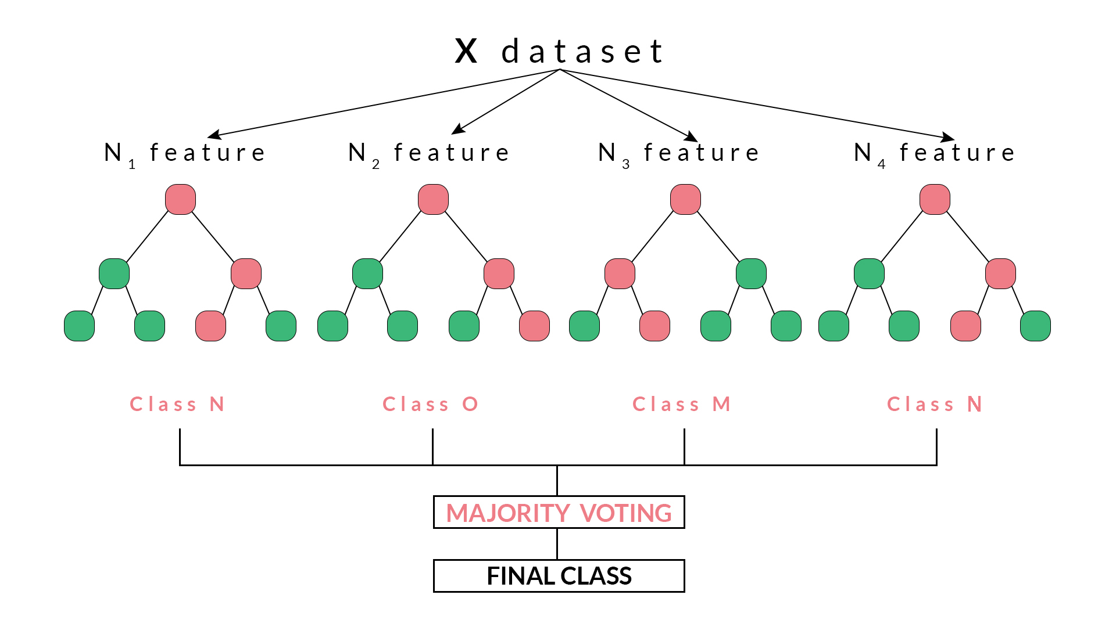
Random Forest
Construct several trees.
Use majority or average vote

Slide 24
Enough talk, let’s do it!

Slide 25
Combatting Overfitting
Split labelled data into training and testing sets
At least 50% for training
Train on training data
Test accuracy on the testing data

Slide 26
Confusion Matrix
Actual Value
 | Positive | Negative
Positive | TP | FP
Negative | FN | TN
Predicted Value

Slide 27
Finding our Neighbours

Slide 28
Let’s try KNN!

Slide 29
Consider the Following
Need model to predict disease in patients.
99% of patients do not have the disease.
How can we maximise accuracy?

Slide 30
My Solution
Always assume patient does not have the disease
99% accurate!

Slide 31
Precision vs Recall

Slide 32
Logistic Regression

Slide 33
Logistic Regression Maths

Slide 34
Let’s try Logistic Regression!

Slide 35
Support Vector Machines

Slide 36
SVM with Non-Linear Data

Slide 37
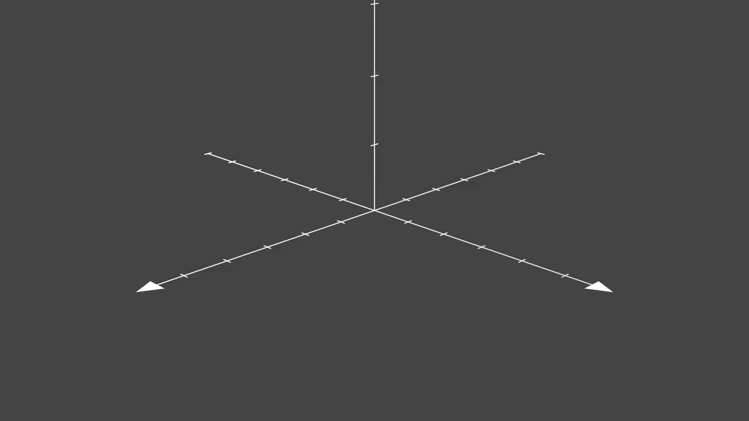
Kernel Trick

Slide 38
Let’s Try SVM!

Slide 39
Dealing with Complex Data
Problems
What if we have hundreds of features?
What about thousands?
Answers
Reduce number of features.
Fine tune hyperparameters.

Slide 40
Hyperparameter Tuning
Very tedious and time consuming.
What happens when search space is high?
SVM: C value, choice of kernel, kernel hyperparameters, etc.

Slide 41
Meta-learning
BIC values for polynomial regression
Grid search in the general case
Create grid of hyperparameter values to test
Find best model

Slide 42
Let’s model some complex data

Slide 43
Up Next Week…
Unsupervised
Clustering
K-means clustering
Hierarchical clustering
DBSCAN
Dimensionality reduction
Principal Component Analysis

Slide 44
Bibliography
Jupyter Notebook: https://jupyter.org/
Google ML glossary: https://developers.google.com/machine-learning/glossary/#m
IBM Machine Learning: https://www.ibm.com/cloud/learn/machine-learning#toc-real-world-Lyja9GSr
GeeksforGeeks Mahcine Learning: https://www.geeksforgeeks.org/machine-learning/

